Slide 1
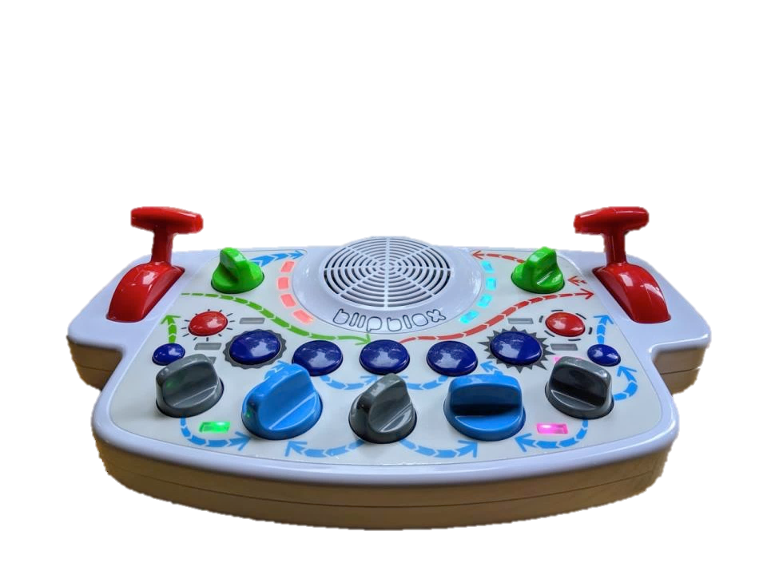
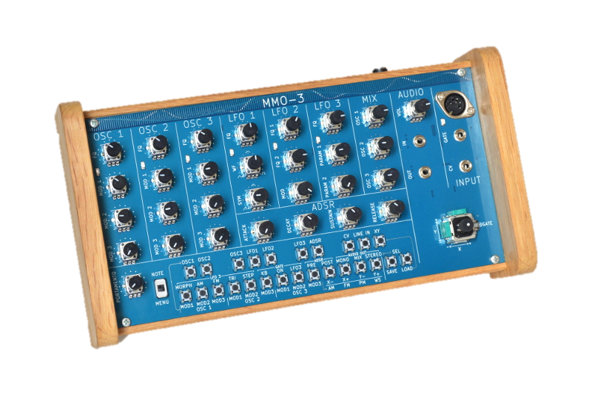
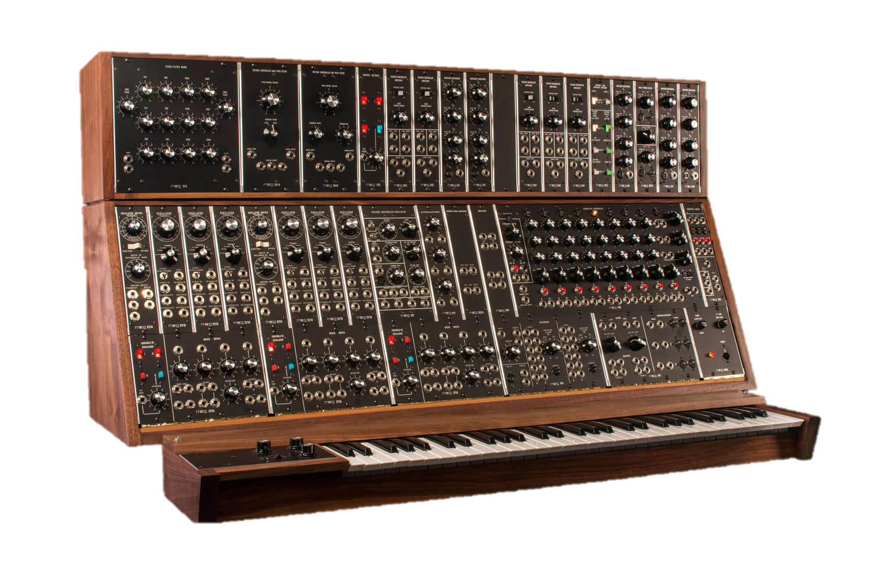
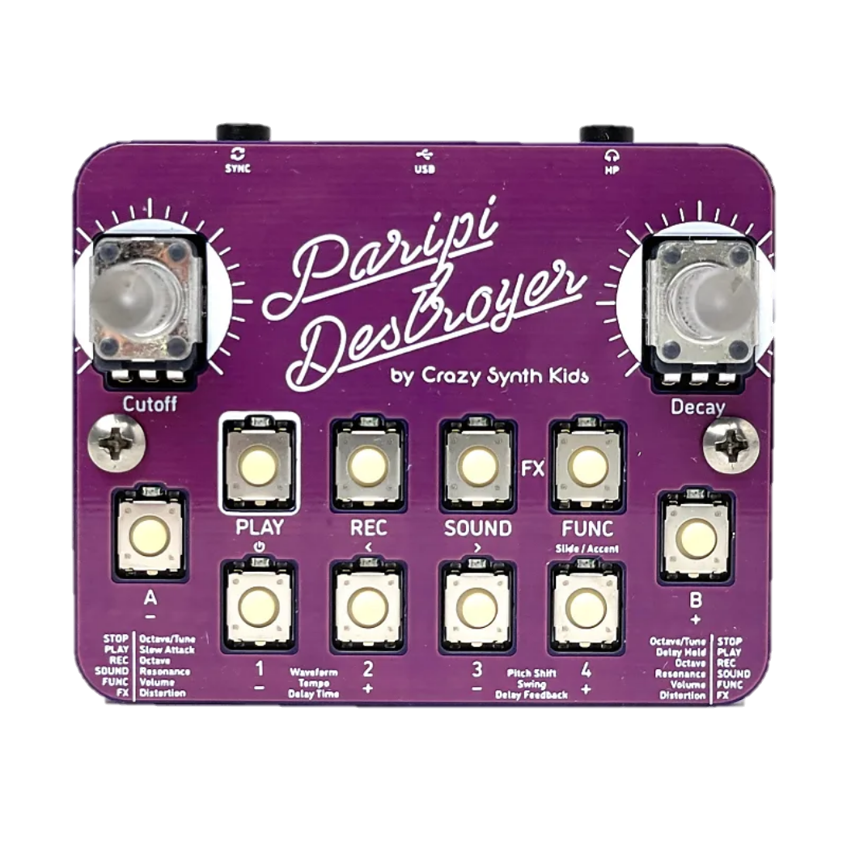

Slide 2
Synthesizer - noun
syn·​the·​siz·​er
a usually computerized electronic apparatus for the production and control of sound (as for producing music)

Slide 3
Synthesizer - noun
syn·​the·​siz·​er
an electronic apparatus capable of producing a wide range of sounds, thus providing for an immersing experience

Slide 4
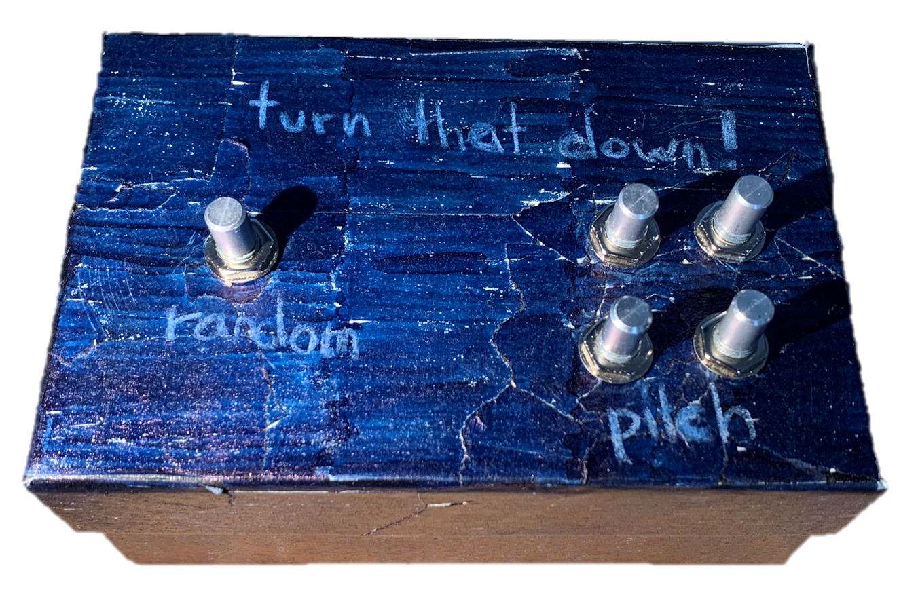
t u r n
t h a t
!
d o w n

Slide 5
turn that down! The Creation of a Synthesizer

Slide 6

content
motivation
theory
my synthesizer
work process
conclusion
demonstration

Slide 7



motivation

Slide 8
theory – building blocks
vco
vcf
vca
lfo
voltage controlled oscillator
voltage controlled filter
voltage controlled amplifier
low frequency oscillator

Slide 9
theory – building blocks
vco
voltage controlled oscillator

Slide 10
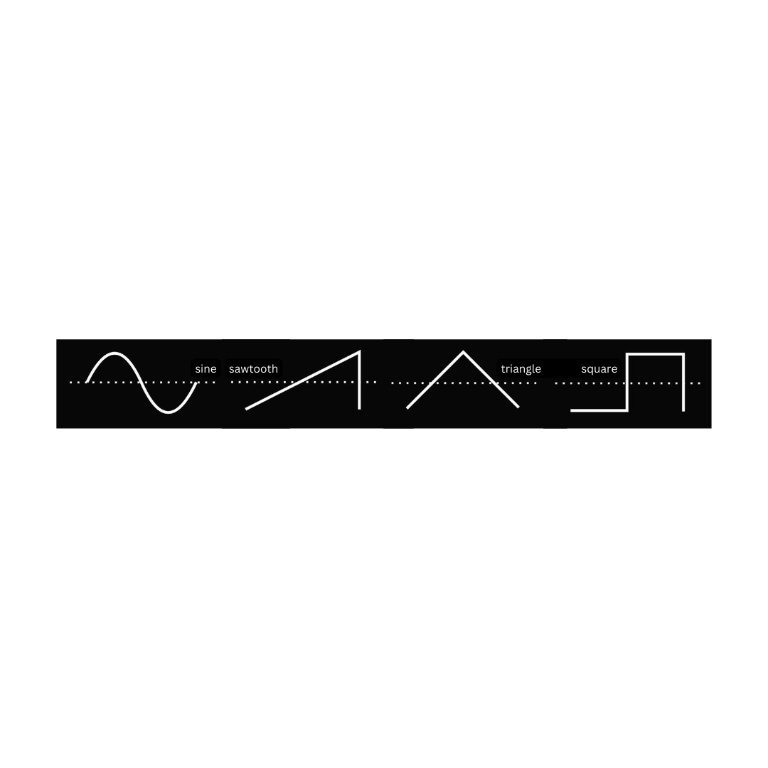

theory - waveshapes
waveshapes

Slide 11
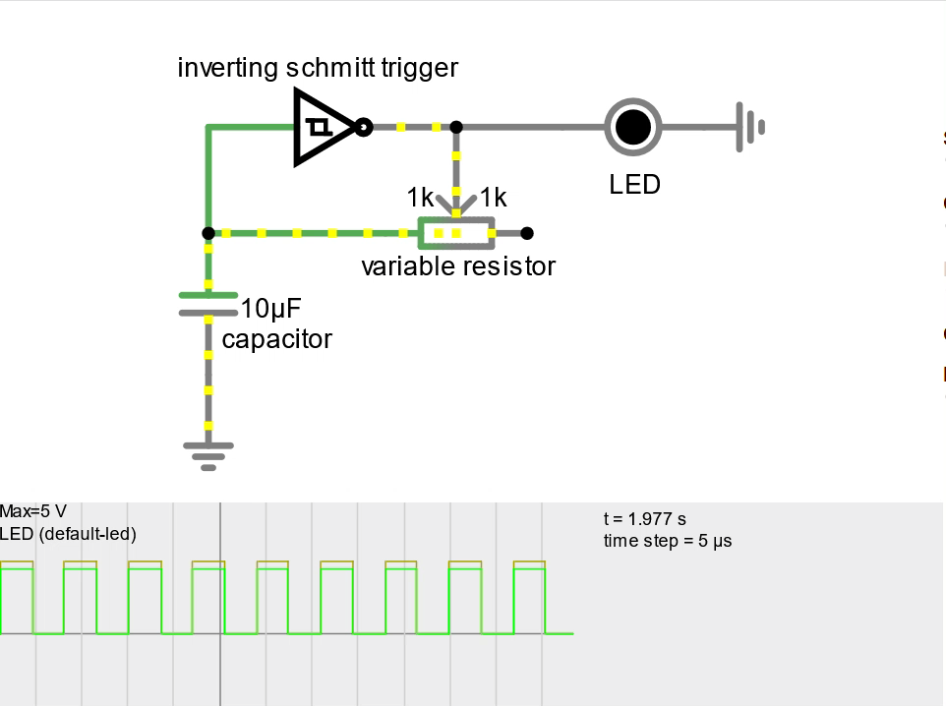
waveshapes

Slide 12
theory – building blocks
vcf
voltage controlled filter
low pass filter - lpf
high pass filter - hpf

Slide 13
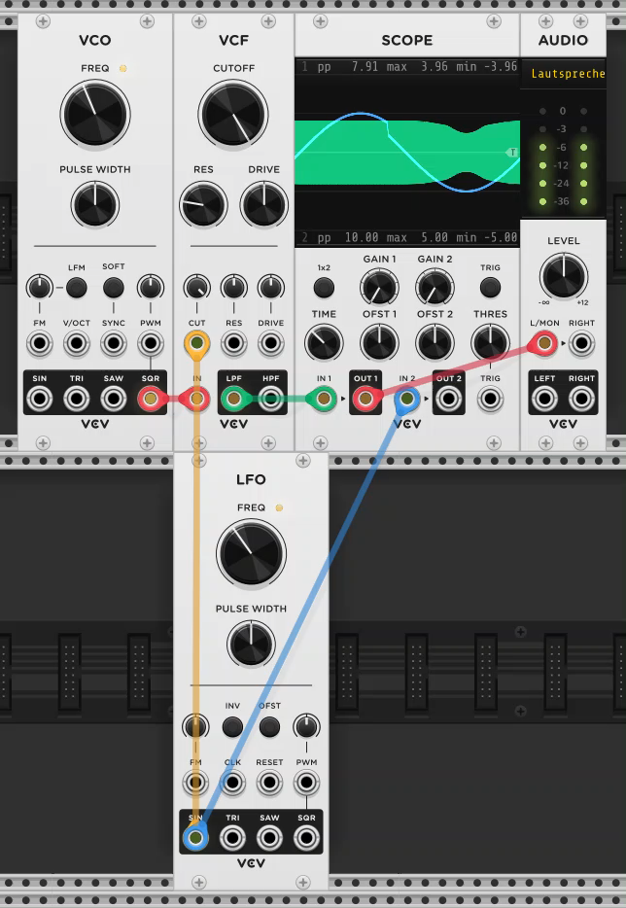

Slide 15
theory – typical architecture

Slide 16
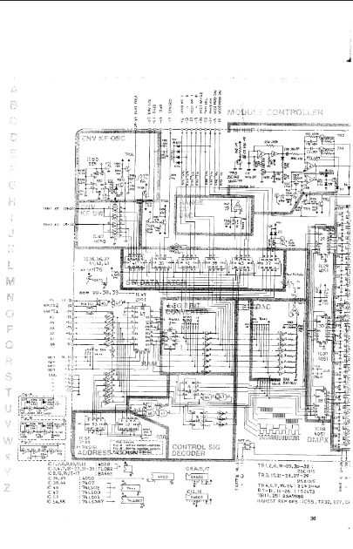
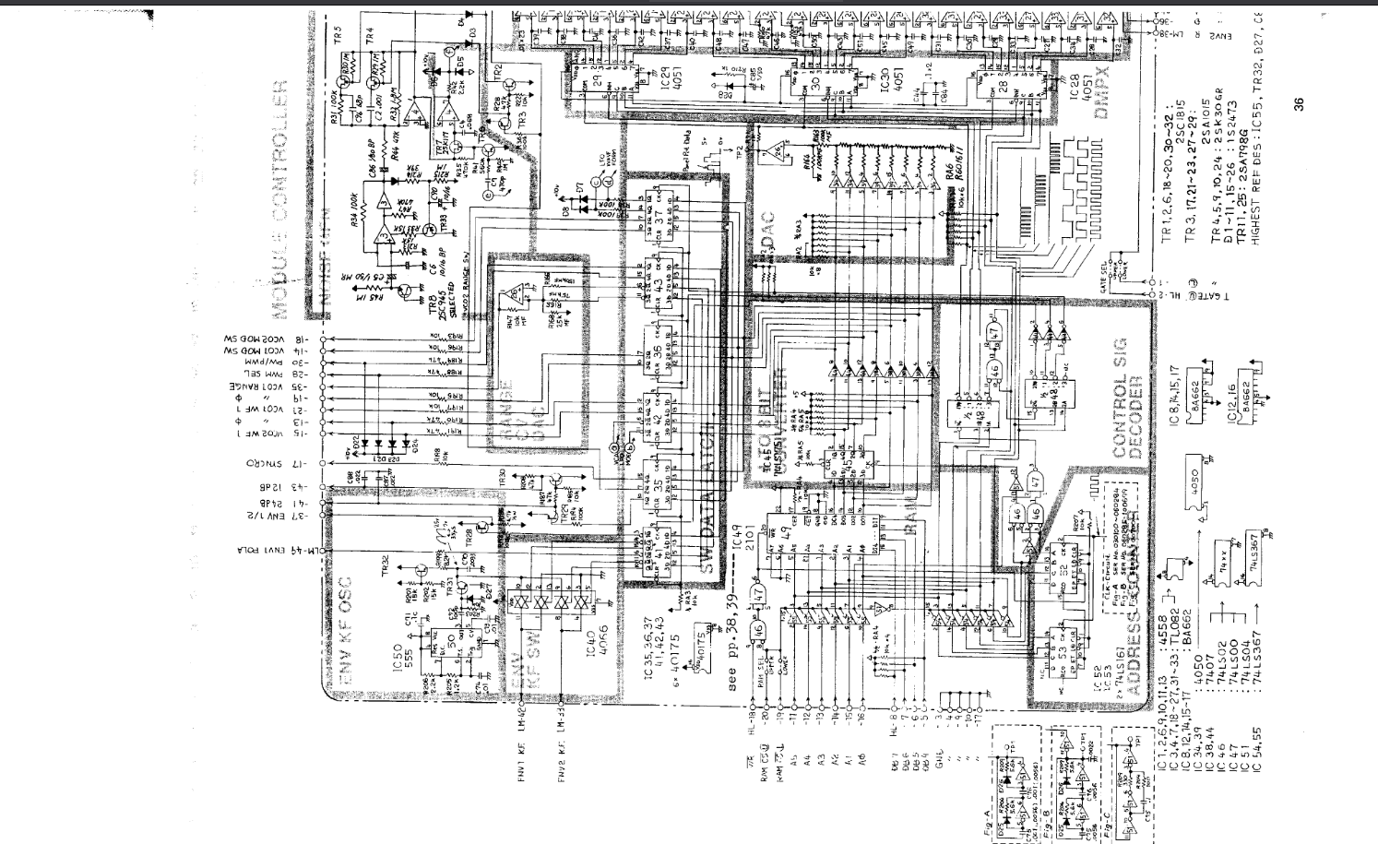
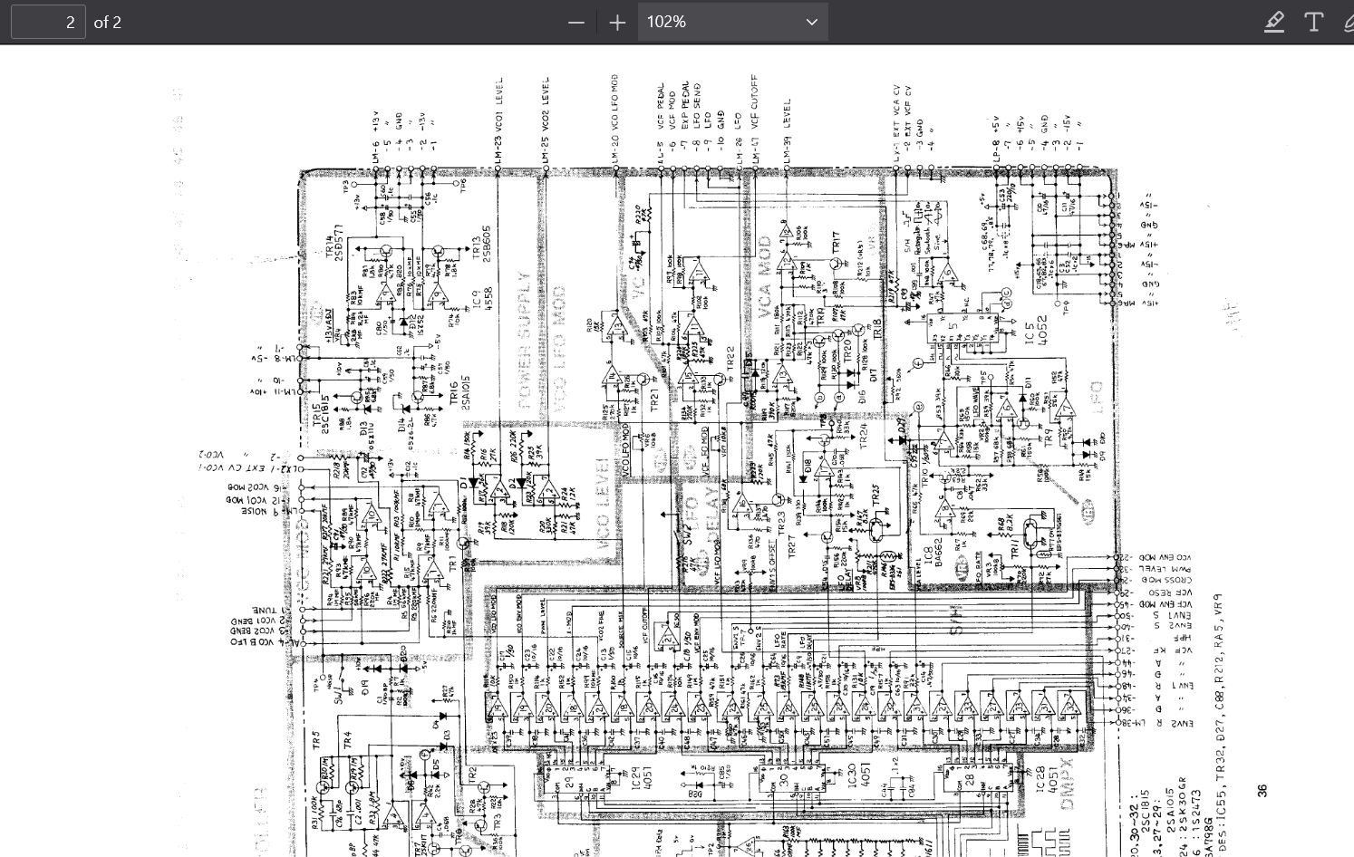
theory
VCO
VCF

Slide 17
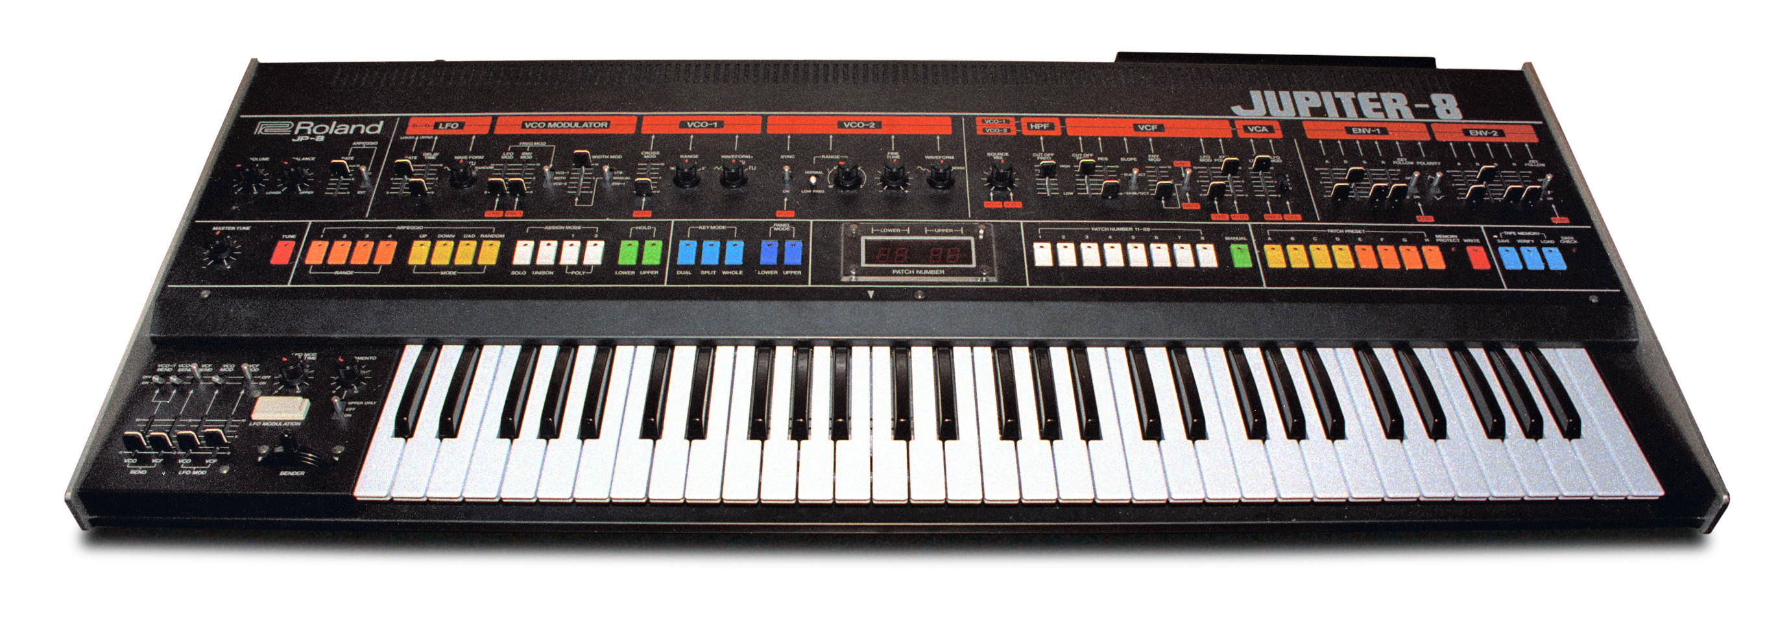
VCO
VCF

Slide 18
theory
VCO
VCF

Slide 19
theory
VCO
VCF

Slide 20
theory
VCO
VCF

Slide 21


my synthesizer
oscillator 1
oscillator 3
output
low pass filter
oscillator 2
oscillator 4

Slide 22
my synthesizer
osc 3
osc 4
output
random
osc 1
osc 2

Slide 23
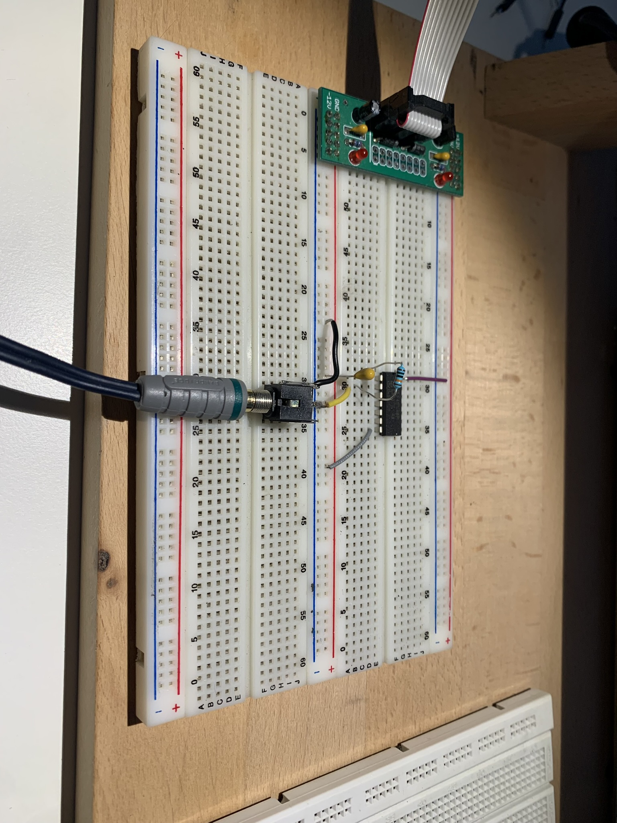
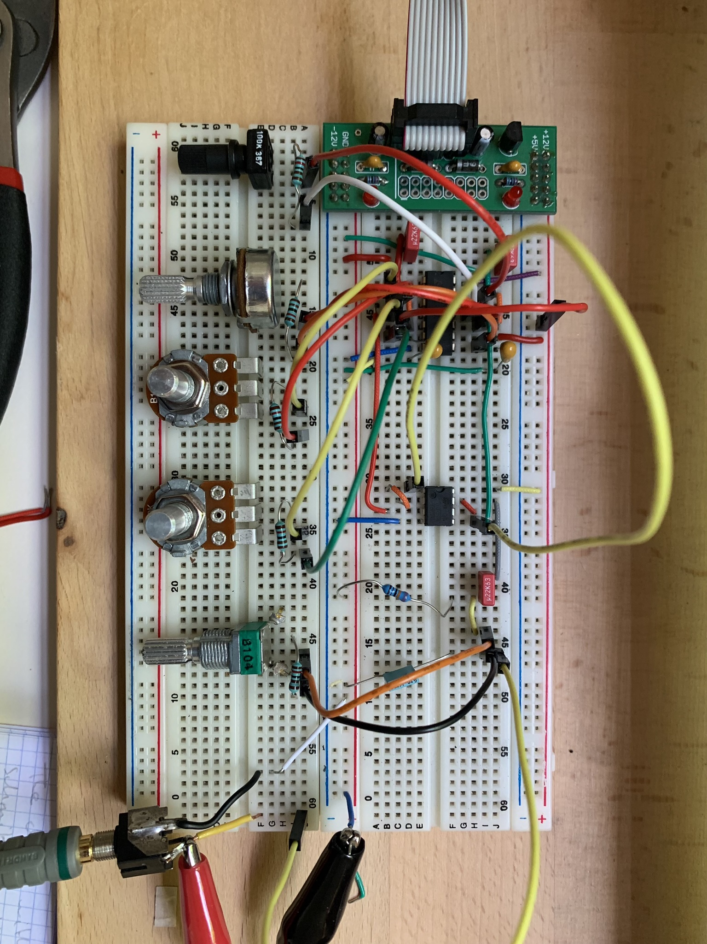
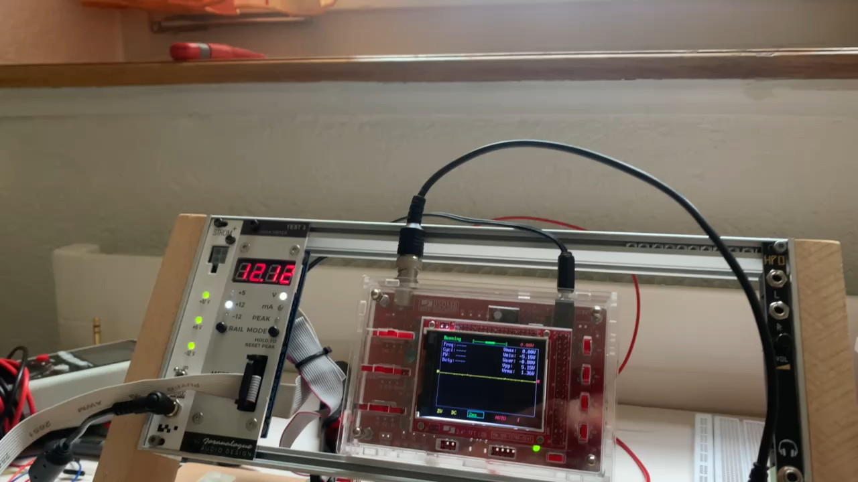
work process

Slide 24
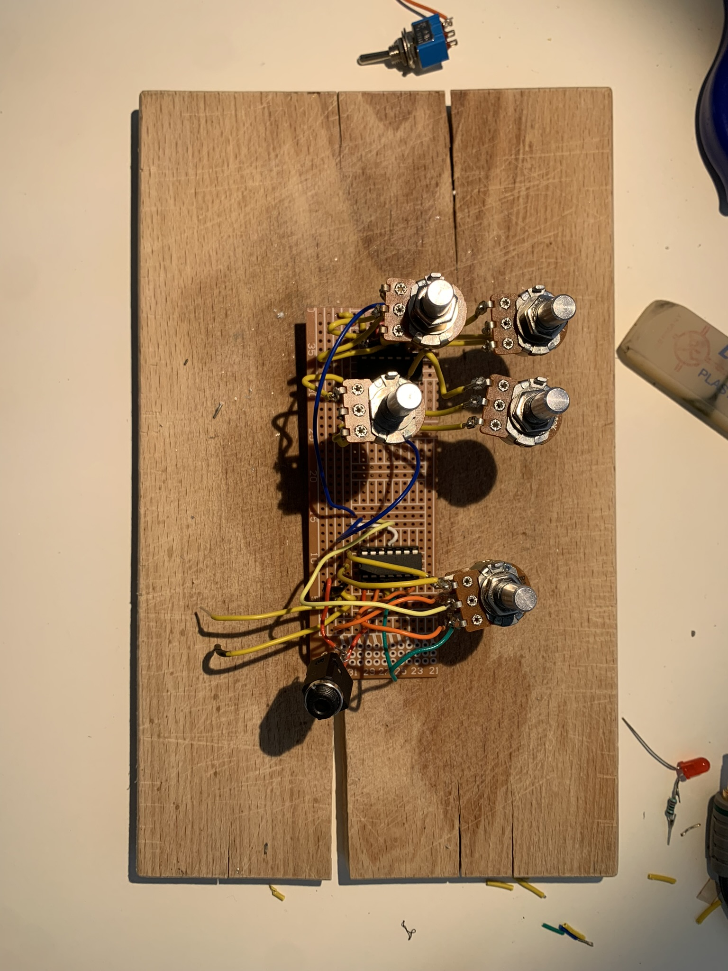
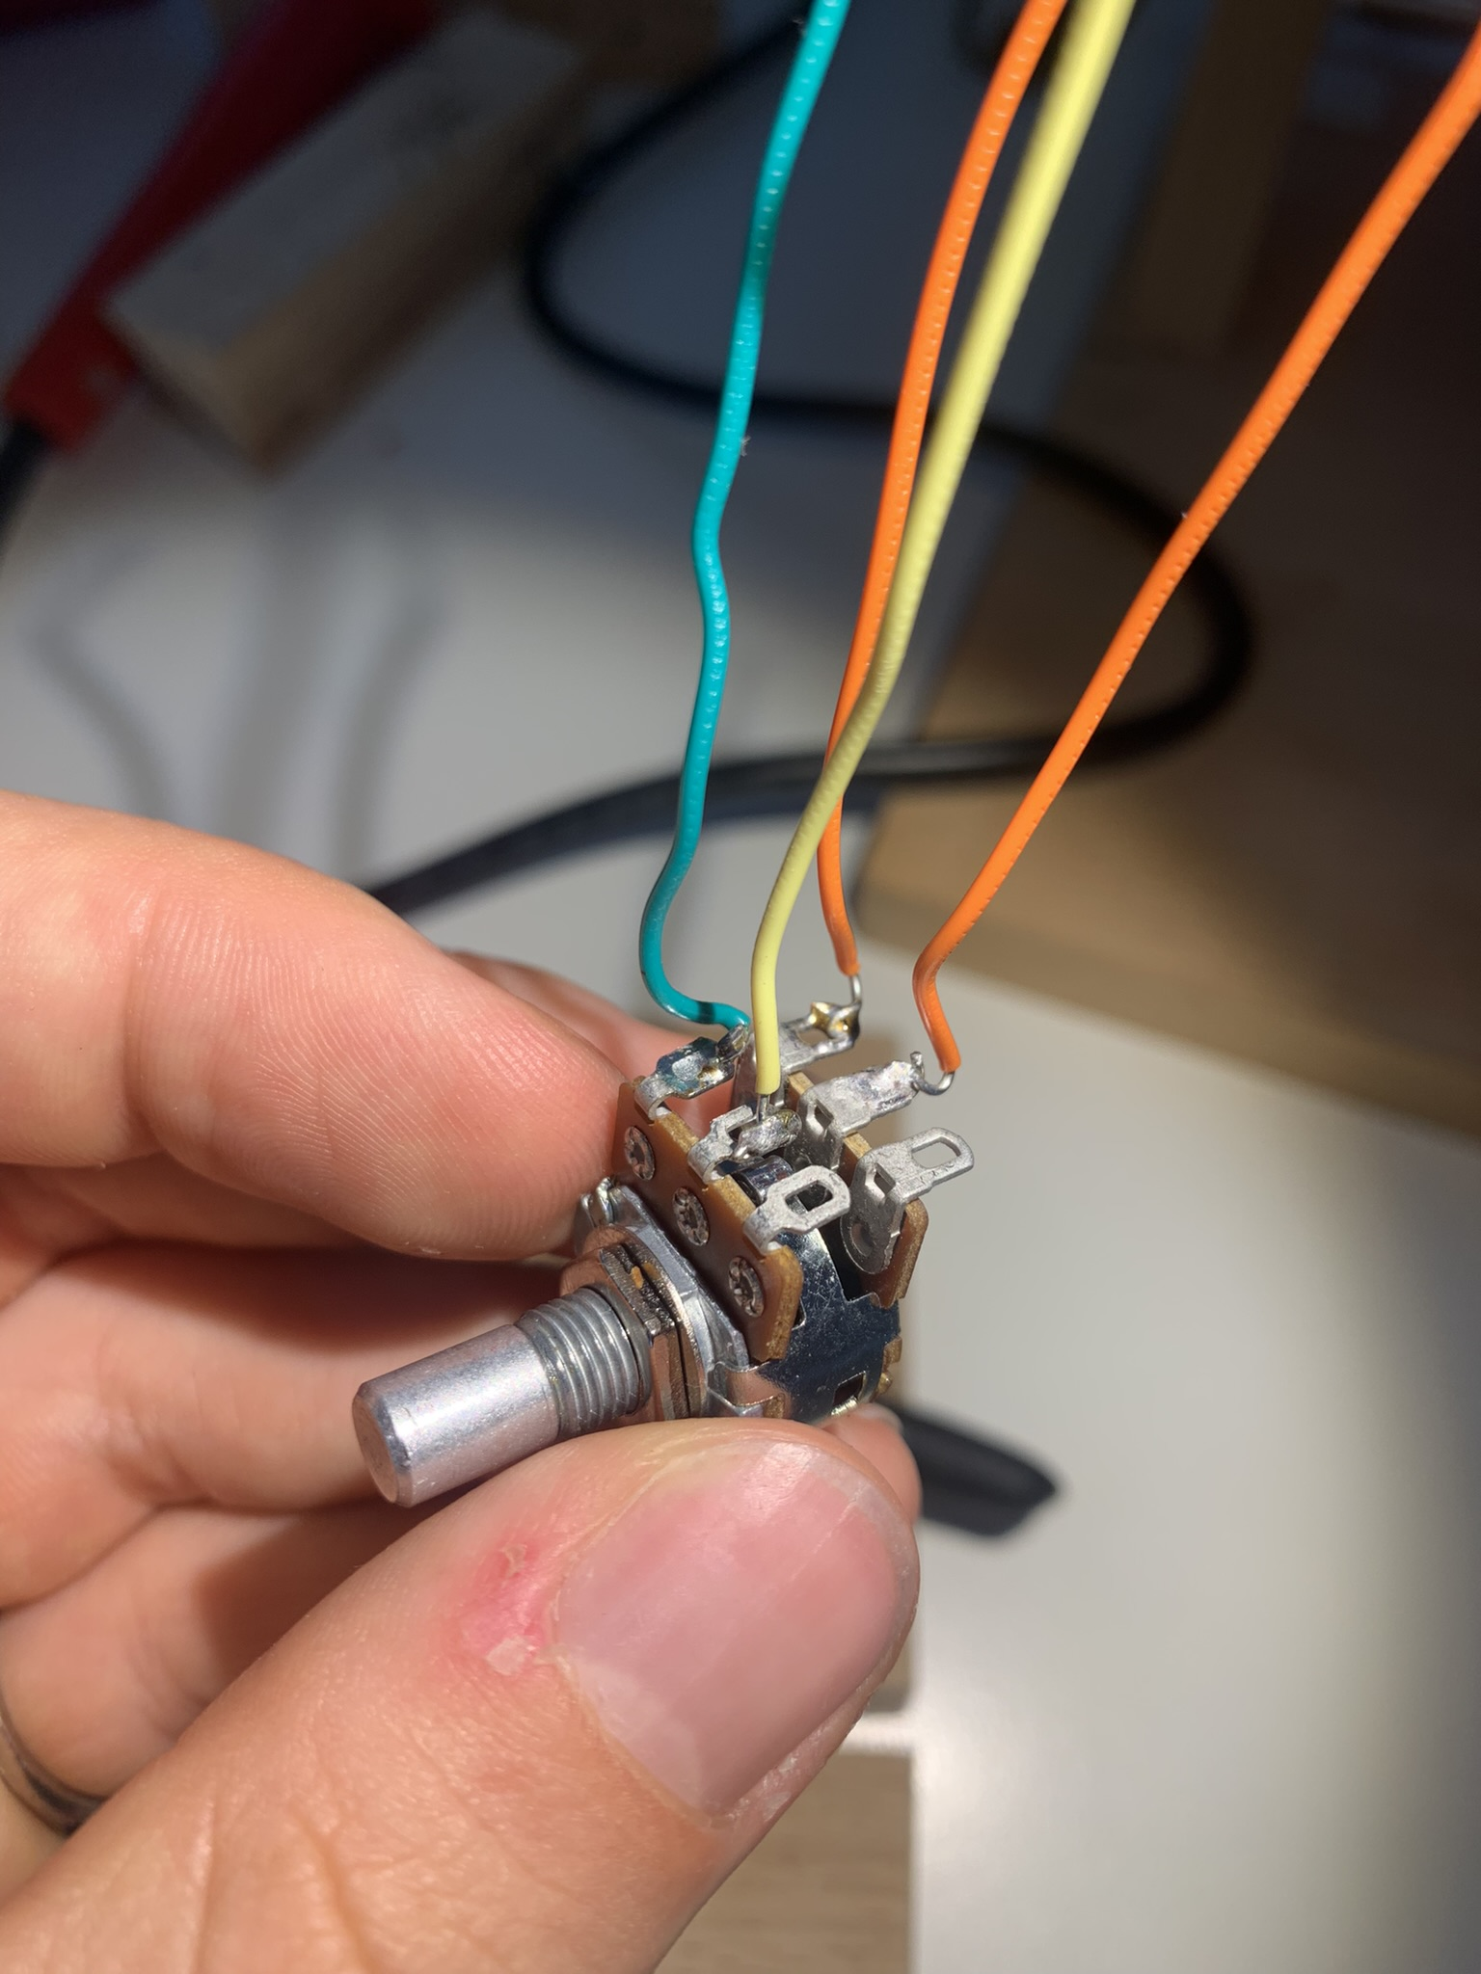
work process

Slide 25
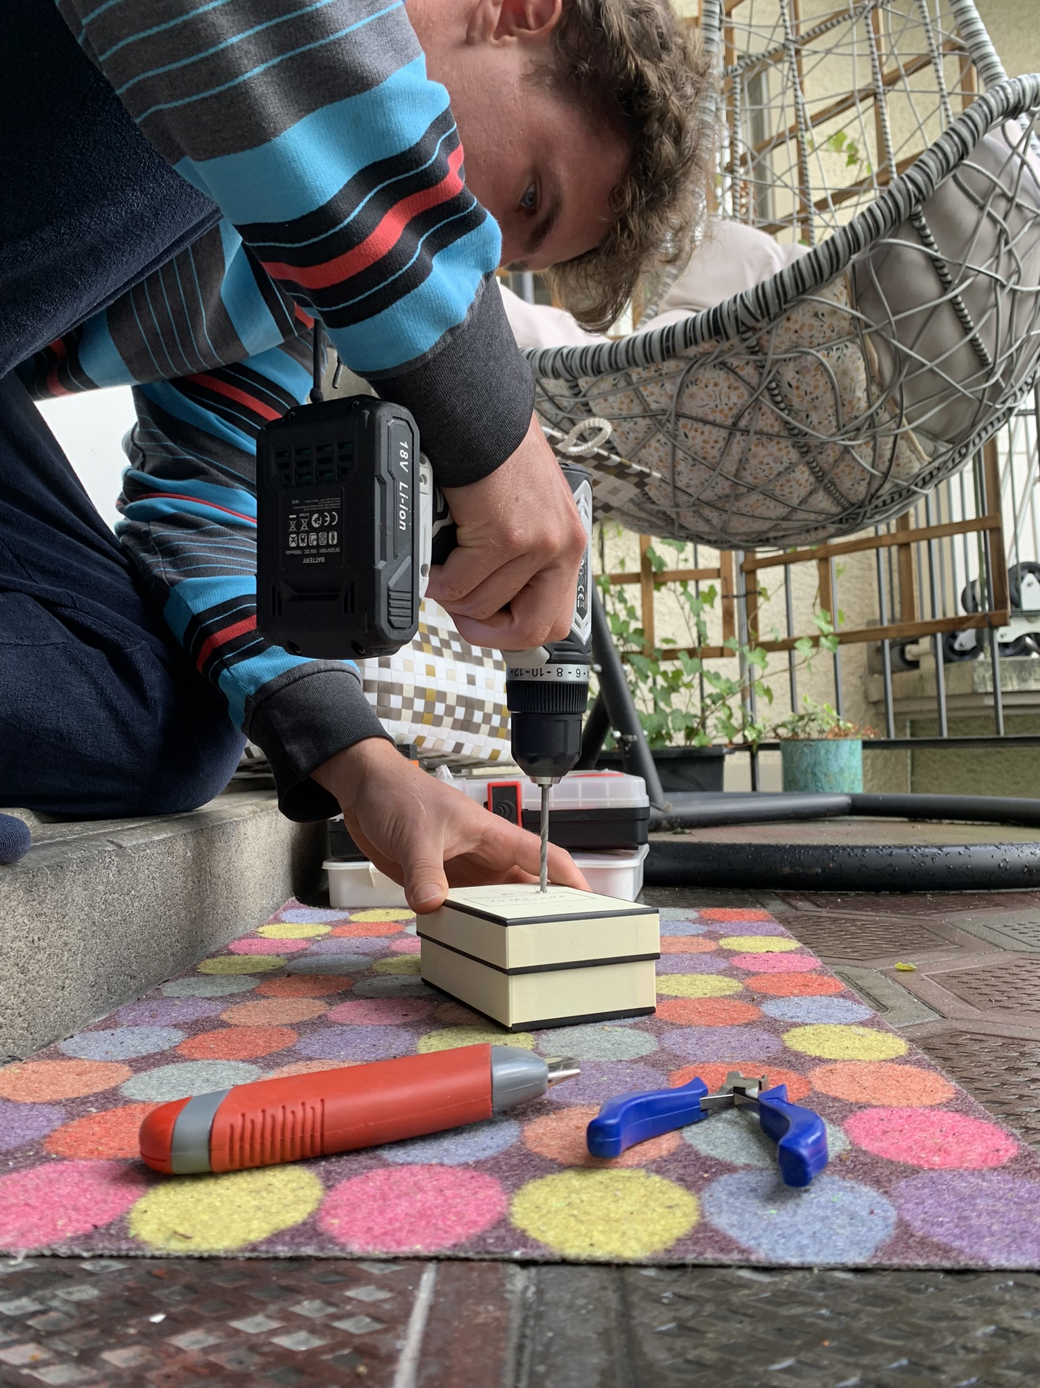


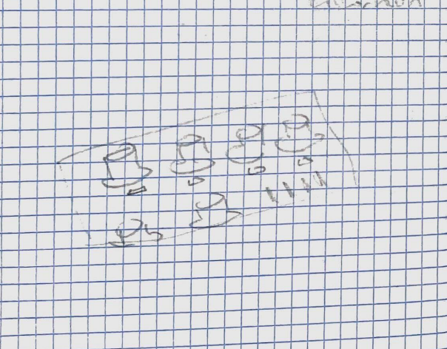
work process

Slide 26
conclusion
possible faults:
cold solder joint
shorted wires
possibility for improvement:
more modules
nicer design
time management
learned a lot
artistic vs scientific

Slide 27
demonstration

Slide 29

link to matura paper

Slide 30
image sources
[1] | Roland, “roland_jp8_service_manual.pdf,” [Online]. Available: https://synthfool.com/docs/Roland/Roland_Jupiter8/roland_jp8_service_manual.pdf [accessed 12 12 2024].
[2] | Wikipedia, “Roland Jupiter 8,” 30 08 2024. [Online]. Available: https://en.wikipedia.org/wiki/Roland_Jupiter-8 [Accessed 12 12 2024].
[3] | moog, “The Return Of The Moog Modular,” [Online]. Available: https://www.moogmusic.com/news/return-moog-modular [Accessed 12 12 2024].
[4] | T. O'brien, “Blipblox is a synth made for kids that adults will like too,” 03 07 2019. [Online]. Available: https://www.engadget.com/2019-07-03-blipblox-hands-on-synthesizer-for-kids.html [Accessed 12 12 2024].
[5] | factmag, “Nozoïd’s MMO-3 could be the ultimate drone synth,” [Online]. Available: https://www.factmag.com/2017/05/24/nozoid-mmo-3-drone-synth/ [Accessed 12 12 2024].
[6] | Reverb, “Crazy Synth Kids Paripi Destroyer,” [Online]. Available: https://reverb.com/uk/item/81622200-crazy-synth-kids-paripi-destroyer-w-box-manual-very-rare-nano-acid-bass-machine-digilog-tokyo [Accessed 12 12 2024].

